Slide 1
Bus Stop Monitoring
Leveraging Data for Seamless Transit
Project by:
Pantelis Glentis 1066464
Evgenia Gkagkastathi 1019191

Slide 2

Challenges In Public Transportation
Public transportation faces challenges impacting efficiency and passenger experience, such as:
Overcrowding at Bus Stations and Buses:
Long wait times leading to unpleasant passenger experience
Increased risk of safety incidents
Illegal Parking:
Disruptions in bus operations
Traffic congestion around stations
Schedule Delays:
Unreliable bus services
Inconvenience for passengers
Potentially increased operational costs for bus companies
These issues not only impact the reliability of the transit system but also lead to frustration among commuters, emphasizing the need for a solution.

Slide 3
Objectives:
The project
is an application designed to efficiently track and manage city bus traffic systems, with a primary focus on meeting the passengers needs.
Provide data-driven insights for effective decision-making.
Enhance overall safety and security at bus stations.
Improve the reliability and efficiency of bus schedules.
Offer passenger-centric services for a seamless transit experience.

Slide 4
Implemented features
Bus Schedule Monitoring
Virtual GPS bus tracking
Notifying the bus drivers of congestion in buses as it occurs.
Retrieving historical data on crowd levels for bus lines at their respective stations.
Crowd Flow Monitoring
Real-time detection of people movement in both bus stations and buses with the use of computer vision technology and virtual data.
Monitoring station and bus occupancy levels and crowd density to effectively track congestion caused by passenger flow.
Obtaining historical crowd level data for specific bus stations within a defined time period.
Illegal Parking Detection
Notifying public authorities of illegal parking on stations as it occurs.
Client services
Website interface providing bus schedule information and real time data
Personalized station selection based on client location using real-time data.

Slide 5
Developer
Simple User
Backend Controller
Admin
MQTT
Orion
Context Broker
The architecture as we implemented it
MongoDB
MongoDB
Raspberry Pis in buses
Edge Controller
Raspberry Pis in stations
MongoDB
MongoDB

Slide 6
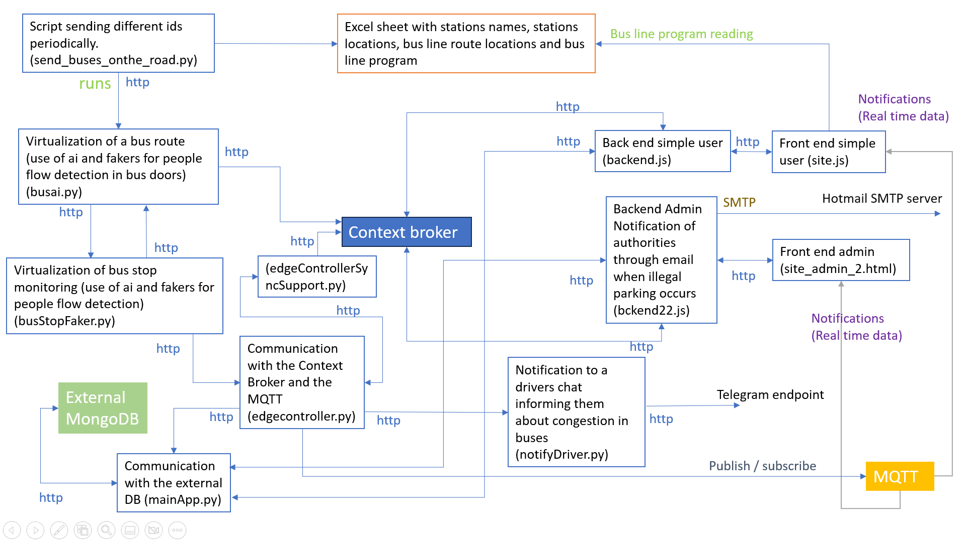

Slide 7
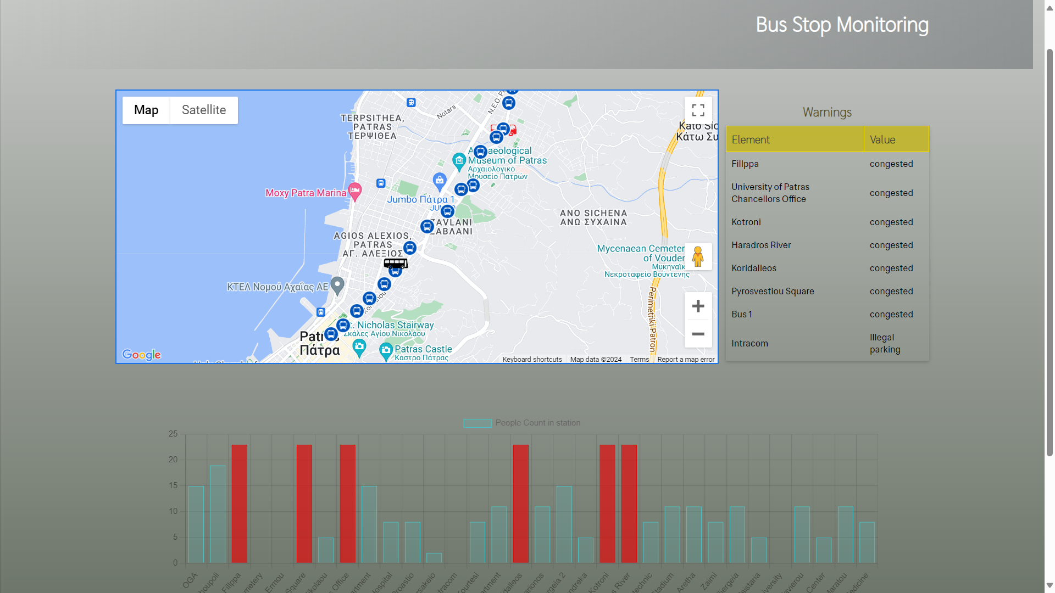
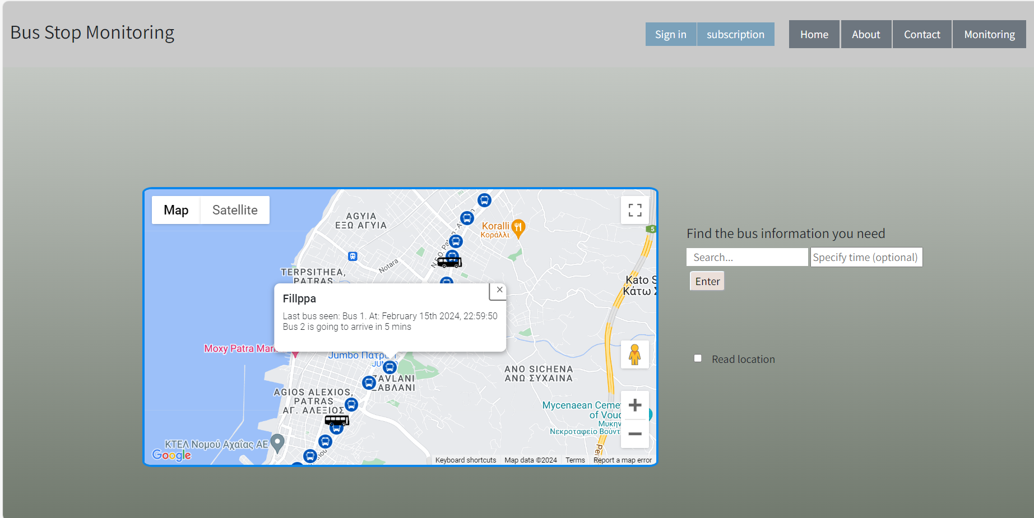
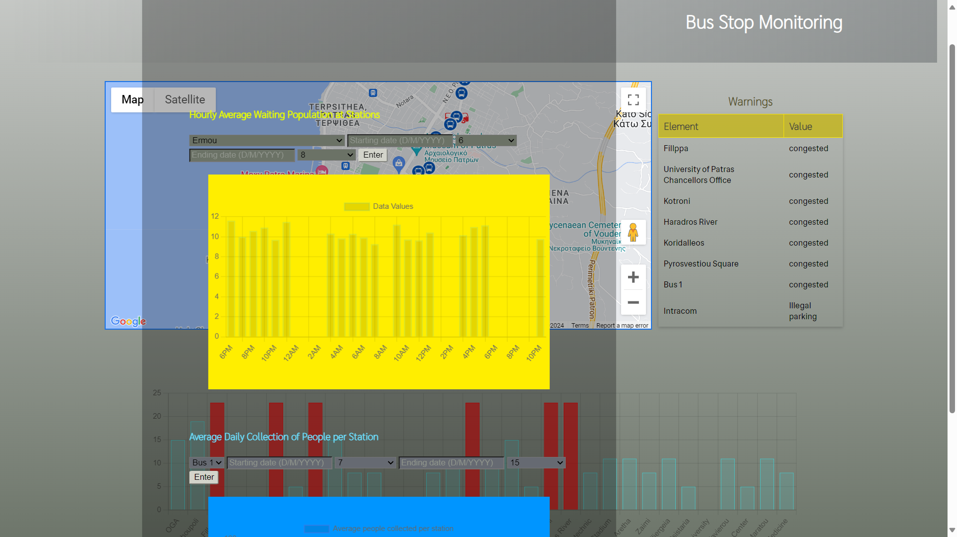
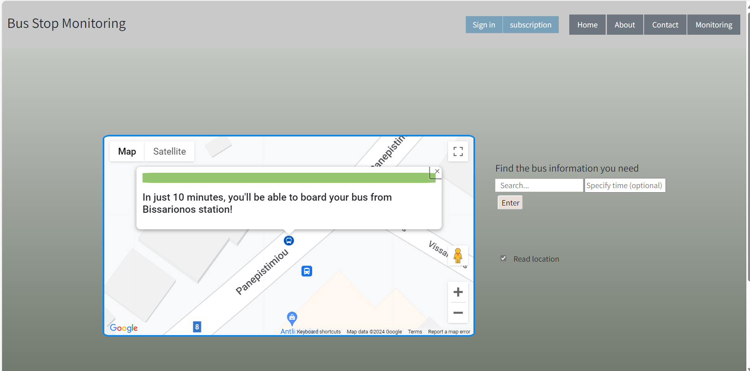
Front End pages

Slide 8

Following Demo Presentation

Slide 9
How we worked
Project
Edge Devices (Fakers)
(Pantelis)
Edge Controller
External database set-up (Mongo)
Methods receiving data from edge devices and crafting payloads
Methods extracting historical data from external database
Posting to Context Broker
Publishing to MQTT Broker
Posting to external database
Posting to telegram endpoint for bus driver alerts
(Evgenia) BackEnd Controllers - Front end pages
Backend requesting information from context broker according to get requests from the front end.
Notifications to authorities about illegal parking in stations.
Front end making get requests to backend.
Subscription to mqtt entities.
Charts and data tables presenting real time data provided by MQTT notifications.
Use of Google APIs that facilitates the delivery of personalized services to users.
(Pantelis)
Bus Station Devices
Synchronizing bus and bus station data
Asynchronous posting of crowd flow in stations every 5 seconds
Posting Illegal parking detection
Bus Station data update when bus has arrived or illegal parking detected
Pausing related fake devices when AI is running. AI implementation detecting crowd flow in station with testing video
(Evgenia)
Bus Devices
First script reading bus location from an Excel document and updating bus location information.
First script notifying bus stops that a bus has arrived in a bus station.
First script asynchronous posting of crowd flow and bus location information to edge controller.
First script using ai for people flow detection from bus doors.
First script generating virtual crowd flow data in stations.
Use of a second script for running the first providing different entity ids.

